Slide 1


K.S.Group of Institutions
K.S.INSTITUTE OF TECHNOLOGY, BENGALURU -560109
Department of Computer Science and Engineering
Project Phase 1+Seminar(17CSP78)
Animal Intrusion Detection Using Machine Learning
Batch No:2020_CSE_17
Under the guidance of By
Sneha. C. R Roshini R:(1KS17CS065)
CSE Department Sindhu M :(1KS17CS079)
KSIT Surakshitha M:(1KS17CS088)
Varshitha S :(1KS17CS095)

Slide 2
INTRODUCTION
Agriculture is considered as a foundation of life, since it is the primary source of food and other raw materials. It plays a crucial part in the country's economic development.
Deforestation, lack of natural prey and habitat loss has forced wild animals to live closely with human settlement prey on domestic livestock. So animals are started attacking humans for their food. Compared with other tiger, elephant entry are in extreme form of conflict and responsible for killing humans lives in India .
Due to human and animal conflict and increase in population humans started demolishing the forest for their existence these leads to harm animals and its habitats. Animals started entering nearby villages due to the rapid growth of industrialization in forest areas. Losing subsistence and dryness makes them raving mad and pretend to attack crops, livestock, sometimes human and farming lands.
Usually, farmers use the electrical fence to protect the field from animals which cause electrocution with cramp makes them behave unusual manner. The safety of animal and human is identically important. To overcome this problem an intelligent monitoring system is required to monitor automatically and recognize the image of animal entry and gives an alert message to human

Slide 3
Examining wild animals in their natural environment is an essential task in ecosystem. Due to the enormous growth in human inhabitants and the increase in hunt of economic development makes excessive exploitation of natural resources, fast, innovative and significant changes in the Earth’s ecosystems.
Hence this proposed system helps to overcome this problem using Machine Learning such as detecting wild animals entering into human habitat and to prevent wildlife poaching and even human animal conflict..
This project uses Convolutional Neural Network (CNN) algorithm to detect wild animals. The algorithm classifies animals efficiently with a good number of accuracy and also the image of the detected animal is displayed for a better result so that it can be used for other purposes.

Slide 4
Literature survey
Content-based Retrieval and Real Time Detection from Video Sequences Acquired by Surveillance Systems.
Authors: Lin jang
Published: IEEE 2014
In this paper, a surveillance system devoted to detect abandoned objects in unattended environments is presented to which image processing content based retrieval capabilities have been added for making easier inspection task from operators.
Video-based surveillance systems generally employ one or more cameras connected to a set of monitors. This kind of systems needs the presence of a human operator, who interprets the acquired information and controls the evolution of the events in a surveyed environment. During the last years efforts have been performed to develop systems supporting human operators in their surveillance task, in order to focus the attention of operators when unusual situations are detected.
Image sequences databases are also managed by the proposed surveillance system in order to provide operators with the possibility of retrieving in a second time the interesting sequences that may contain useful information for discovering causes of an alarm.
Experimental results are shown in terms of the probability of correct detection of abandoned objects and examples about the retrieval sequences.

Slide 5
Study of Motion Detection Method for Smart Home
Authors:Mayur J. Charadva
Published in:International Journal of Innovative Research in Advanced Engineering (IJIRAE) ISSN: 2349-2163 Volume 1 Issue 5 (June 2014)
Motion detection surveillance technology give ease for time-consuming reviewing process that a normal video surveillance system offers. By using motion detection, it save the monitoring time and cost.
It has gained a lot of interests over the past few years. In this paper, a proposed motion detection surveillance system, through the study and evaluationof currently available different methods.
The proposed system is efficient and convenient for both office and home uses as a smart home security system technology.

Slide 6
Motion Detection for Security Surveillance
Authors: yin lang
Published in: IEEE 2015
This paper deals with the design and Implementation of Smart surveillance monitoring system using Raspberry pi and CCTV camera. This design is a small portable monitoring system for home and college security.
This system will monitor when motion detected, the Raspberry Pi will control the Raspberry Pi camera to take a picture and sent out image to the user according to the program written in python environment. The proposed home security system captures information and transmits it via a Raspberry towards pc.
Raspberry pi operates and controls motion detectors and CCTV camera for remote sensing and surveillance, streams live records it for Future playback. Python software plays an important role in this project. Motion detection systems are a necessity in the modern times. Although some people object theidea of being watched, surveillance systems actually improve the level of public security , allowing the system operators to detect threats and the security forces to react in time.
Surveillance systems evolved in the recent years from simple CCTV systems into complex structures, containing numerous cameras and advanced monitoring centres, equipped with sophisticated hardware and software. However, the future of surveillance systems belongs to automatic tools that assist the system operator and notice him on the detected security threats. This is important, because in complex systems consisting of tens or hundreds of cameras, the operator is not able to notice all the events.

Slide 7
Problem identification
Farmers are always exposed to various external risks like weather dependence, market prices, inputs availability etc. Another potent risk for farming is damage to crops by stray/ wild animals.
The animals, reacting to the loss of their forest habitat and a scarcity of food, frequently invaded the farmland around the village, trampling on plants and crops and destroying incomes . Everything the villagers tried to deter the animals – digging trenches, beating traditional drums, installing solar-powered electric fences, or planting shrubs with supposed repellent qualities – proved ineffective. One after another, residents began to give up farming.

Slide 8
Problem statement
In forest borders, the conflict between human and animals is continuously increasing as animals tend to stray into areas of human habitation. It is extremely difficult to monitor and track certain animals such as wild pachyderms due to their nature of movement and size.
Automatic detection of animals that have strayed into human inhabited areas has important security and road safety applications. This paper attempts to solve this problem using deep learning techniques from a variety of computer vision fields including object detection, segmentation, tracking and edge detection.
As a solution to this issue, a system that can help in identification of intrusion of wild animals at agricultural farms by means of Machine Learning. This paper attempts to solve this problem using deep learning techniques from a variety of computer vision fields including object detection, segmentation, tracking and edge detection for detecting animals.
The proposed system can be used for the for-edge decisions in real time using edge computing.

Slide 9
scope
To design a security system for farm protection
Prohibit the entry of animal into the farm
Design a system that sounds when animal tries to enter into the farm
In night flashlight will focus on that side.
The camera continuously monitors the fields and provides the video feed to the farmer at home 24×7 for the whole day
The system ensures that the alarm is not triggered by the presence of a human in the field, or via any random motion.
The system is capable monitoring and warding of animals thus protecting the fields from any damage also we can setup a Timer as per farmer’s requirement

Slide 10
Goals and objectives
The Main objectives of the project are:
To capture the image of the intruder and classify them.
To provide protection from the attacks of the wild animals and thus minimizing the probable loss to the farmer. To detect intrusion around the field.
Taking suitable action based on the type of the intruder. To send notification to farm owner and forest officials.
To protect human life from the attacks of wild animals and vice-versa

Slide 11
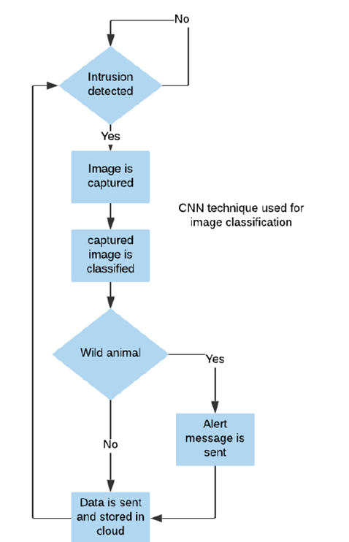
methodology

Slide 12
To Detect Intrusion in the Field
Camera data is continuously analyzed to check any change in the frame Using Some Background Subtraction Method
To Capture the image and Classifying Them Using Image Processing
Input from the camera is processed. Classification of image is done using Convolution Neural Network . Classifying whether human or the animal is domestic or Wild Animal.
Taking Suitable action based on the intruder
After Image processing and classification. If Human or Wild Animal is detected, processor turns an alarm and intimation alert to Concerned Persons.
To send Notification to farmers and Forest Officials
An intimation alert is sent to farmer about animal presence. We Use Twillio Messenger to send intimation alert to farmer

Slide 13
Expected outcomes
Classification of Input Data into animal and Humans
Classification of animal Type
Intimation to concerned Person through Mail and Message

Slide 14
Contribution to society
The problem of crop vandalization by wild animals has become a major social problem in the current time. It requires urgent attention and an effective solution. Thus, this project carries a great social relevance as it aims to address this problem. Hence, we have designed a smart embedded farmland protection and surveillance-based system which is low cost, and also consumes less energy.
This system is totally harmless and doesn’t injure animals in any way. It also doesn’t cause any harm to humans. Also, this system has a very low power requirement thus reducing the hazards of electric shocks.
The main aim is to prevent the loss of crops and to protect the area from intruders and wild animals which pose a major threat to the agricultural areas. Such a system will be helpful to the farmers in protecting their orchards and fields and save them from significant financial losses and also saves them from unproductive efforts that they endure for the protection of their fields. This system will also help them in achieving better crop yields thus leading to their economic wellbeing

Slide 15
References
”Real-Time Monitoring of Agricultural Land with Crop Prediction and Animal Intrusion Prevention using Internet of Things and Machine Learning at Edge” by R Nikhil, B S Anisha and P Ramakanth Kumar,2020
“Internet of Things based Wild Animal Infringement Identification, Diversion and Alert System” by Muneera Begum H,Janeera.D.A,Aneesh Kumar.A.G,2020

Slide 16
Thank you

